Slide 1
First semester project
Group: 3
Gabriel Marcel Muresan
Laszlo Czegledi
Razvan Gabriel Cirstea
Victor Alexandru Carmocanu

Slide 2
Introduction Vestbjerg Byggecenter A/S
Steps in development
Upgrade the old software system
Meet the company’s requirements
Staff member management
Customer management
Stock control
Product tracking

Slide 3
Organizational Culture
Organization founded : 1987
CEO – Anders Olesen – old fashioned
Two sons hired in management
Timber Department
DIY
Leadership style : consulting

Slide 4
Financial Position
The profitability is increasing since 2009 to 2010 with smaller assets but after that the profitability changes again
The earning capacity increases every year from 2009 to 2011

Slide 5
Solution
Prioritizing of Classes used
Person – abstract class
Employee
Customer
Contractor
Product (ProductCollection - singleton)
Category (CategoryCollection - singleton)
Order(OrderCollection - singleton)
Lease(LeaseCollection - singleton)

Slide 6
SWOT Analisis Strenghts
Having leaders with experience in the domain
Motivational leaders
Good educational profile
Good relationship between managers and employees
Problems are resolved in a professional manner
Organizing different recreational activities that build relationships
Long term employees
High information level in the company
The company is part of the XL-Byg chain
Many regular customers [1000]

Slide 7
SWOT Analysis Weaknesses
Oudated computer system
Hard traking of inventory and goods
Low stock control and information
Lines of autorithy can be dificult for related leaders
Too fixed groups of customers and payment methods [22 in number]

Slide 8
SWOT Analisis Opportunities
Use the influence in the chain for development purposes
Development of the new system could allow them to accept more orders giving them a bigger turnover
Further expansion of the company
Develop the company's website to advertise and get more regular customers
Improve the flexibility of peyment methods and customer catecorization

Slide 9
SWOT Analysis Threats
The market has a lot of competition
The computer system should be finished fast because they are being left behind on the technology
If they do not increase the discounts for regular customers they could find another provider

Slide 10
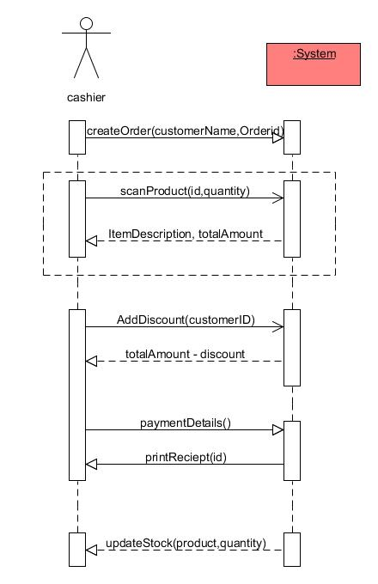
Use-case: Order
ID: 107VH
Actor: cashier
Precondition: Customer has an account in the system
Post condition: Purchase is successfully registered and a receipt is printed.
A customer arrives at a checkout with items to purchase.
The cashier creates a new order.
The cashier use the barcode scanner to record each purchased item and enters the number of item.
The system updates the new stock.
Cashier asks the customer for a payment method (cash/card)
System generates the total amount.
The customer asks for payment to be added to his account.
A purchase is being registered in the system and an invoice is being printed and added to other invoices customer has on his account (if any).
The system updates inventory.
The customer receives a dispatch note.

Slide 11
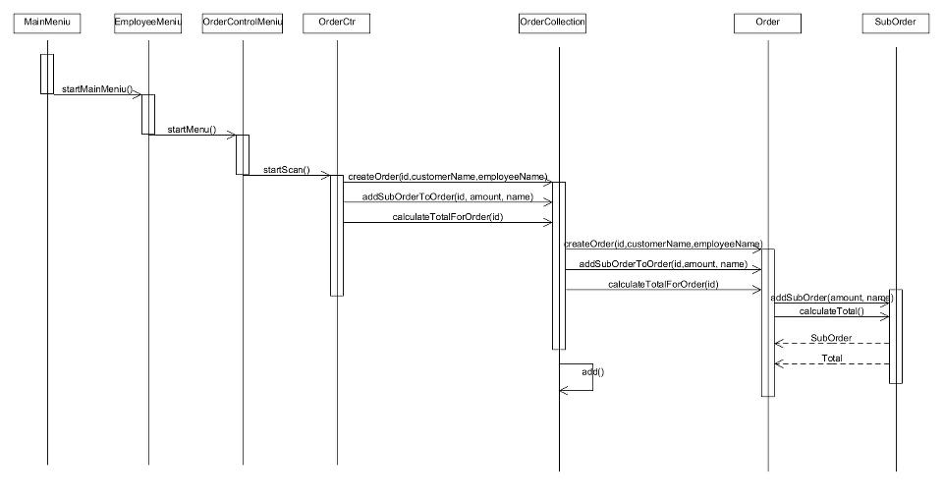

Slide 12
Solution

Slide 13
Evaluation of the group process
The group showed a very high level of convergence.
Everyone helped each other on their tasks
The group decided who does which task and after a brief setup/sketch of the task we called the group together for a personal meeting
Spent time for each task/outline to rate it and brainstorm about it.
We found this way a quite good one because everyone had the freedom to work on his own
We used the power of the group to use our combined ideas and fix the problems.
Everyone was able to keep the deadline on each task and made his best.

Slide 14
Did WE reach the group goals?
We did reach the group goals. These goals were:
Cooperate with each other as much as possible
Avoid the conflicts
Solve the upcoming conflicts
Keep focused on the task
Ask for others opinion always, so we can get a better view on the task
Make a schedule and meet the deadlines
Do our best always

Slide 15
Conclusion
The system is able to:
Create and add
Products
Employees
Customers
Contractors
Etc.
Manage and update
Stock
Leases
Orders
Employees
Customers
Etc.
Track location
Manage statistics

Slide 16

THE END
THANK YOU FOR YOUR ATTENTION

